Slide 1
Silicon on insulator

Slide 2
SOI(silicon on Insulator structure)refers to the use of a layered silicon-insulator-silicon substrate in place of conventional silicon substrates.
SOI based devices differ from conventional silicon built devices in that the silicon junction is above an insulator, typically sio2 or sapphire.
The choice of insulator depends largely on intended application ,with sapphire being used for radiation sensitive applications.
The precise thickness of the insulating layer and topmost silicon layer also vary widely with application

Slide 3
In SOI,the devices on silicon thin film(SOI layers)that exist on insulating film.
In CMOS devices,P/N tpe MOS Transistors are isolated from the well layer.

Slide 4
Advantages of SOI Technology
Reduced Source and Drain to Substrate Capacitance.
Lower substrate capacitances provide the possibility for faster circuits.
No field inversion problems exist (insulating substrate).
There is no latchup because of the isolation of the n and p transistors by the insulating substrate.
Because there is no conducting substrate there are no body effect problems
There is enhanced radiation tolerance
Absence of Latchup.
Lower Passive current.
Denser Layout (due to absense of wells,transistor structure denser than bulk silicon are feasible)

Slide 5
Advantages
Higher integration density(because of the absence of well regions)
Complete avoidance of the latch up problem.
Lower parasitic capacitances compared to the conventional n-well or twin-tub CMOS Process.
Disadvantage
Considerably more costly than standard n-well CMOS Process.

Slide 6
Characterstics of SOI-CMOS Devices:
A low operating voltage is possible since the threshold voltage can be set low .
Development of High speed low power consumption CMOS devices is possible since the load capacitance is reduced.(Reduced junction capacitance)
Realizing high frequency component performance is possible since high resistance si wafers can be used as supporting substrates
Reduced operation errors such as cross talk,latch up phenomena.

Slide 7
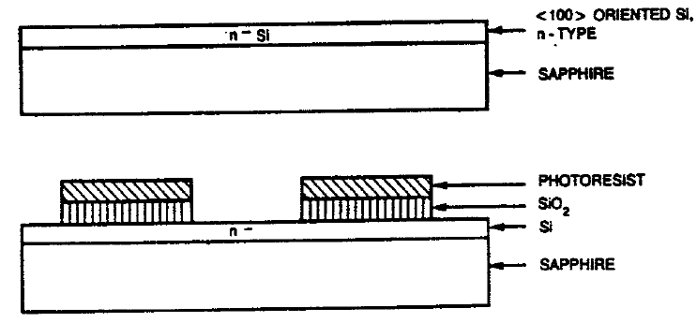
SOI-CMOS process

Slide 8
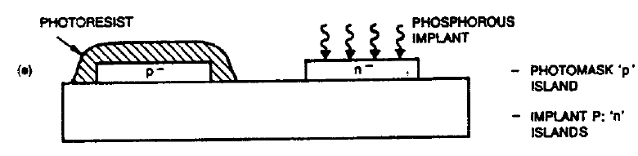

Slide 9
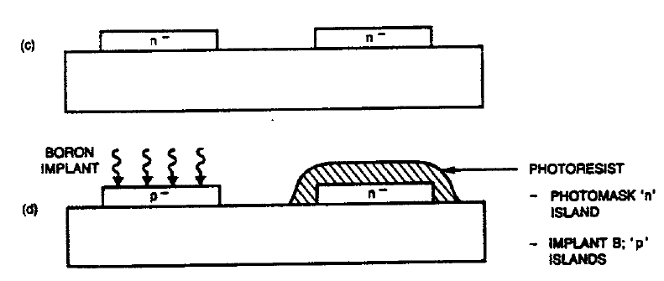

Slide 10
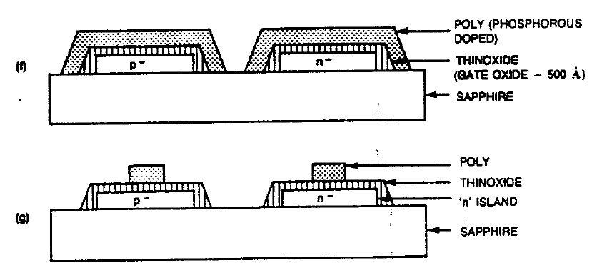

Slide 11
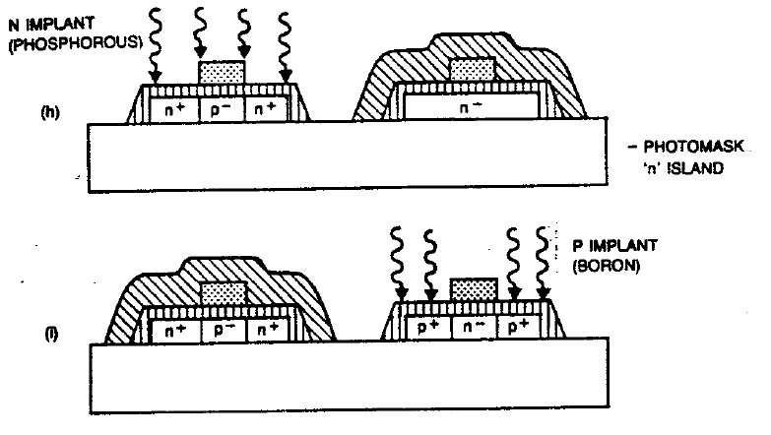

Slide 12
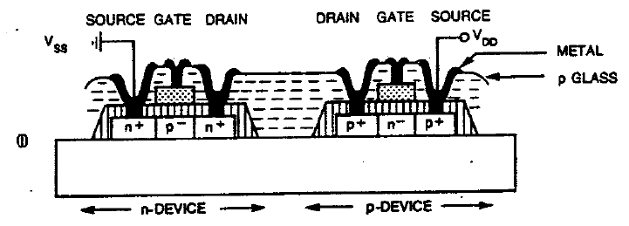

Slide 13
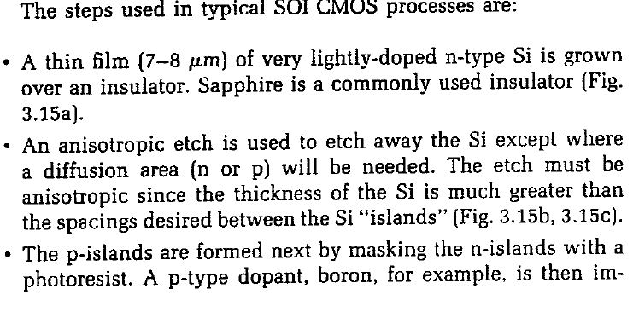

Slide 14
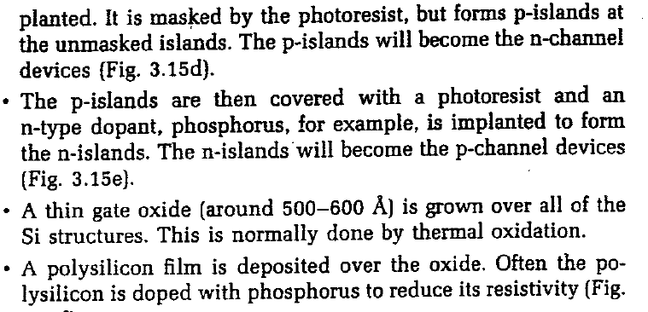

Slide 15
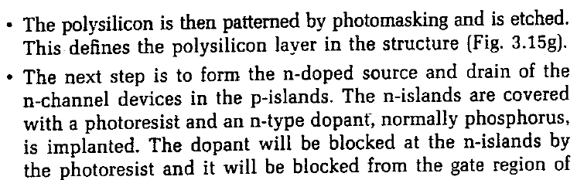

Slide 16
